Slide 1
The Birds of a Feather Research Challenge
Todd W. Neller
Gettysburg College
November 9th, 2017

Slide 2
Outline
Backstories:
Rook Jumping Mazes
Parameterized Poker Squares
FreeCell
Birds of a Feather
Rules
4x4 Single Stack Play
Experiments
Brainstorming

Slide 3
Rook Jumping Maze Design
Rook Jumping Mazes - logic mazes with simple rules based on Chess rook moves
Few maze designers in history had the skill to create these.
We worked together to create a metric to rate the quality of mazes and performed combinatorial optimization to generate high quality mazes.

Slide 4
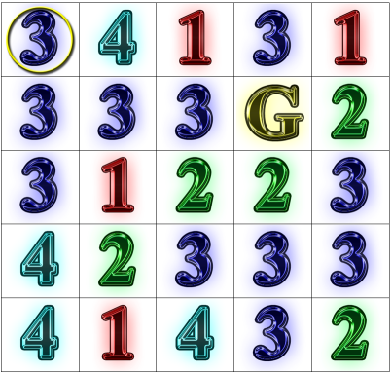
Example Maze
Specification: grid size, start state (square), goal state, jump numbers for each non-goal state.
Jump number: Move exactly that many squares up, down, left, right. (Not diagonally.)
Objectives:
Find a path from start to goal.
Find the shortest of these paths.

Slide 5
Publication
in van den Herik, H. Jaap, Iida, Hiroyuki, and Plaat, Aske, eds., LNCS 6515: Computers and Games, 7th International Conference, CG 2010, Kanazawa, Japan, September 24-26, 2010, Revised Selected Papers, Springer, 2011, pp. 188-198.

Slide 6
Parameterized Poker Squares
Materials:
shuffled standard (French) 52-card deck,
paper with 5-by-5 grid, and
pencil
Each turn, a player draws a card and writes the card rank and suit in an empty grid position.
After 25 turns, the grid is full and the player scores each grid row and column as a 5-card poker hand according to a point system.

Slide 7
American Point System
Poker Hand | Points | Description | Example
Royal Flush | 100 | A 10-J-Q-K-A sequence all of the same suit | 10♣, J♣, Q♣, K♣, A♣
Straight Flush | 75 | Five cards in sequence all of the same suit | A♦, 2♦, 3♦, 4♦, 5♦
Four of a Kind | 50 | Four cards of the same rank | 9♣, 9♦, 9♥, 9♠, 6♥
Full House | 25 | Three cards of one rank with two cards of another rank | 7♠, 7♣, 7♦, 8♥, 8♠
Flush | 20 | Five cards all of the same suit | A♥, 2♥, 3♥, 5♥, 8♥
Straight | 15 | Five cards in sequence; Aces may be high or low but not both | 8♣, 9♠, 10♥, J♦, Q♣
Three of a Kind | 10 | Three cards of the same rank | 2♠, 2♥, 2♦, 5♣, 7♠
Two Pair | 5 | Two cards of one rank with two cards of another rank | 3♥, 3♦, 4♣, 4♠, A♣
One Pair | 2 | Two cards of one rank | 5♦, 5♥, 9♣, Q♠, A♥
High Card | 0 | None of the above | 2♦, 3♣, 5♠, 8♥, Q♦

Slide 8
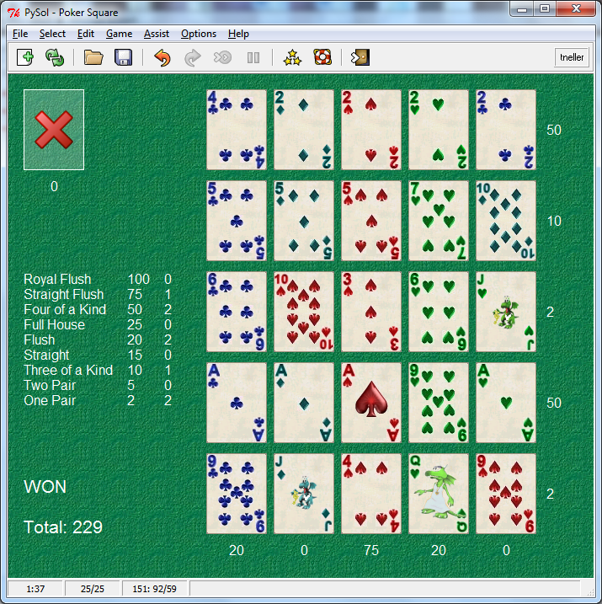
Scoring Examples

Slide 9
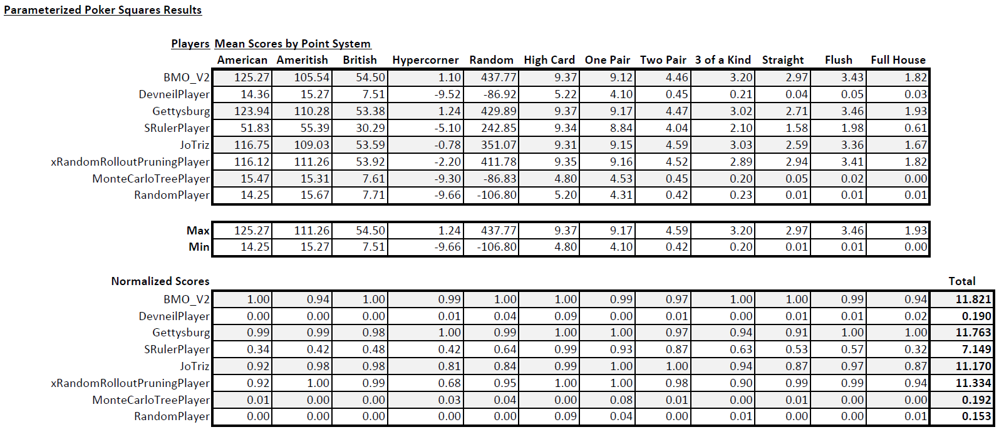
Competition Results

Slide 10
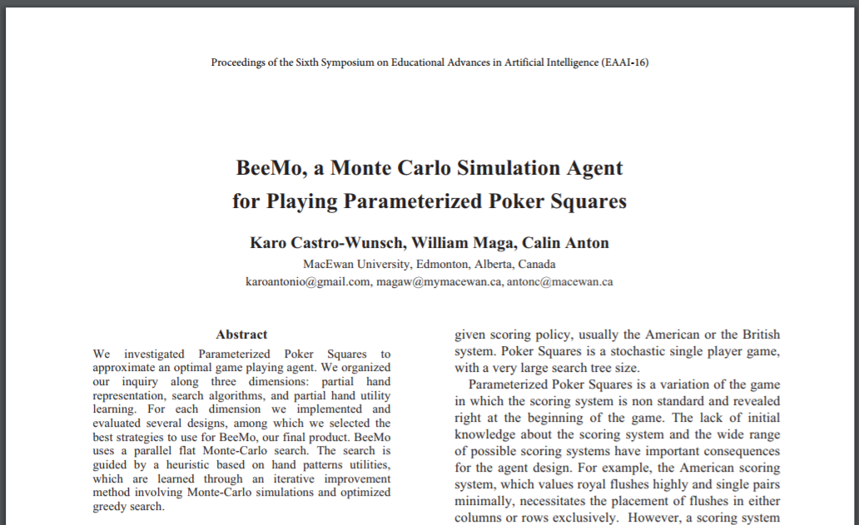
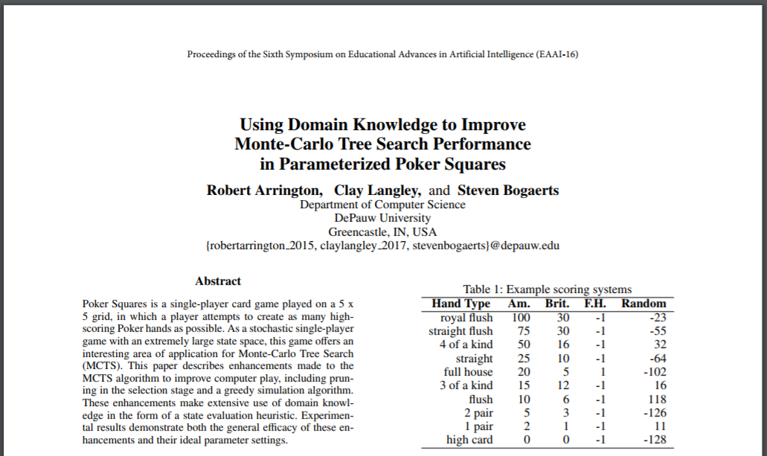
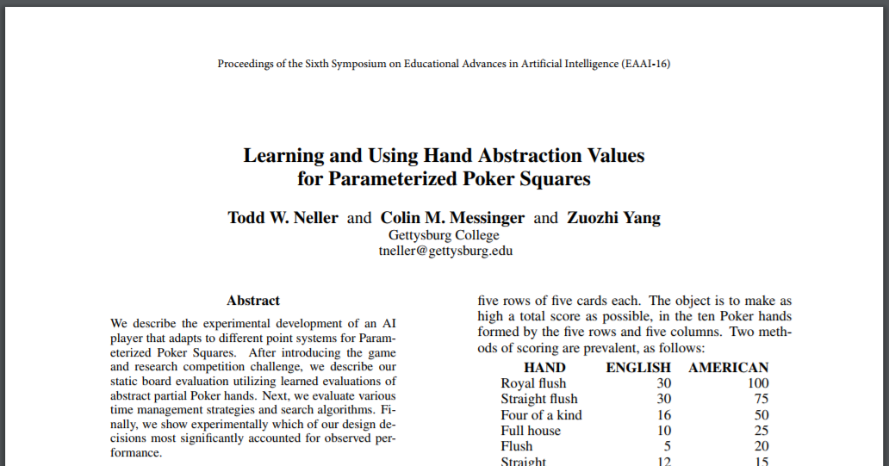
Publications

Slide 11
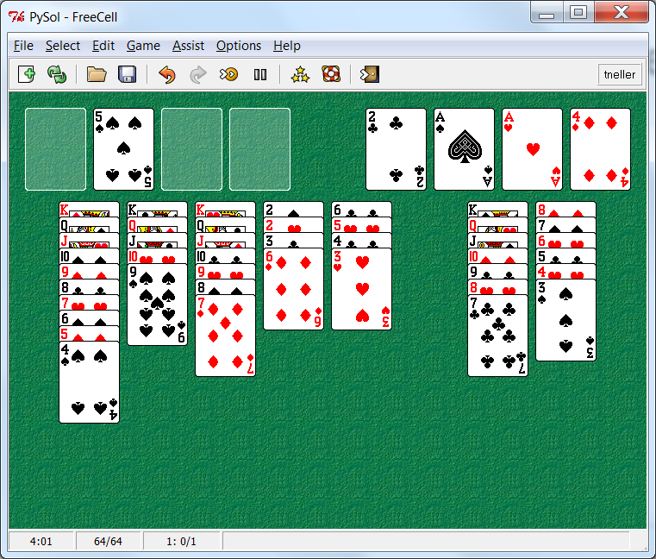
FreeCell Solitaire Card Game

Slide 12
FreeCell Characteristics
Randomly generated, but no chance after face-up deal (perfect information) → Combinatorial game
Self-generating puzzle that is solvable with high probability
Invited many interesting research questions posed and solved by skilled enthusiasts
See Michael Keller’s FreeCell FAQ: http://solitairelaboratory.com/fcfaq.html
Would have been great for undergraduate research, but largely harvested.
To gain new low-hanging fruit, plant a new tree!

Slide 13
Birds of a Feather Characteristics
Randomly generated, but no chance after face-up deal (perfect information) → Combinatorial game
Self-generating puzzle that is solvable (for certain deal dimensions) with high probability
Invites many interesting research questions (to be introduced later)
But first, we introduce the game…

Slide 14
Birds of a Feather
“Birds of a feather flock together.”
Designed August 9, 2016
Materials: a standard, shuffled 52-card deck
Setup: Deal cards singly, face-up into a grid (e.g. 4-by-4).
Object: Form a single stack of all cards.
Play: A player may move one stack of cards onto another stack of cards in the same row or column if the cards on top of the stacks have either
(1) the same suits, or
(2) the same or adjacent ranks. Aces are low and not adjacent to kings, so rank adjacency is according the ordering A, 2, 3, …, J, Q, K.

Slide 15
Birds of a Feather: Adjacent Rank

Slide 16
Birds of a Feather: Same Suit

Slide 17
Birds of a Feather: Same Rank

Slide 18
Birds of a Feather: Single Stack Goal

Slide 19
Birds of a Feather Java Project
Import Eclipse Java project…
File → Import… → General → Existing Project into Workspace
Select “Select Archive File” radio button and click “Browse” button.
Select /Courses/Colloquia/tneller171109/BirdsOfAFeather.zip
Click “Finish”
Open BirdsOfAFeather.java (GUI) in project BirdsOfAFeather
Run

Slide 20
Birds of a Feather Example Deal

Slide 21
Birds of a Feather Example Solution
TS-9H AH-TH AH-3H AH-QH 6H-7D JS-JC KS-3S KS-KC 5S-KS 6H-5C 5S-TS AH-8H 6H-AH 5S-6H 5S-JS

Slide 22
Experiment 1: Are all 4x4 deals solvable?
Open Experiment1.java and run.
Program attempts to solve deal 0, 1, 2, …
Are all solvable? If not, what is the first that isn’t solvable?
Press the red square by the Eclipse console window to terminate the experiment.
Run BirdsOfAFeather and type ‘s’ to create seed 10 puzzle.
What makes this unsolvable?
Type ‘t’ to toggle connections between flockable card pairs.
Let’s call a single unflockable card an odd bird.

Slide 23
Experiment 2: Do all unsolvable deals have an odd bird?
For efficiency, we’ll divide the solving ranges and work in parallel. Wait for your input parameters.
Open Experiment2.java and run. Odd bird deals will be identified and skipped.
Every time you find an unsolvable deal (odd bird or otherwise), add it to your list of unsolvable deal numbers and note if it is an odd bird deal.
After covering your range, examine any unsolvable deals using BirdsOfAFeather.java. If there are no unsolvable deals or they’re easily understood, examine deal 1163 or 1264.

Slide 24
Example Research Questions
m-by-n single-stack deal solvability/scoring:
What is the probability that a deal will have a single-stack solution?
What is the maximal score distribution of deals?
Which features of a puzzle can guide a computer efficiently to a successful solution?
Which algorithms work best to solve such puzzles?
What are characteristics of grids without single-stack solutions?
Puzzle solving heuristics:
Which features of a puzzle can guide a player to a successful solution?
Puzzle design:
How would you create a metric for a good BirdsOfAFeather puzzle?
Which techniques work best for designing puzzles for such a metric?
How can one generate a succession of gradually more difficult puzzles to guide and teach a player to solve such puzzles well?

Slide 25
Conclusion
Birds of a Feather offers a new landscape for research exploration.
Together, we can understand more about puzzle solving, puzzle design, etc. and gain research, writing, presentation, and publication experience in the process.
Please contact Todd Neller (tneller@gettysburg.edu) if you’re interested!

