Slide 1
Game Engine Programming

Slide 2
Game Engine Components
Physics Engine
(Bullet)
Game
Engine
Rendering Engine
(OGRE)
XML Parser
(TinyXML)
Renderer
(OpenGL)
Graphical User Interface
(CEGUI)
Input/Output System
(OIS)
Audio Output
(OpenAL)

Slide 3
Game Components
Models
Textures
Scenes
Animations
Images
Scripts
GUI Layouts
Materials
A.I.
Saved
Data
GUI
Layout
Sound/
Music
System
Config.
Video
Keyboard
Mapping

Slide 4
Game Loop
configuration();
create_the_scene();
while(!done){
read_input_state();
update_game_objects();
render_scene();
} //end while
clean_up();

Slide 5
Timing
Each iteration of the loop varies in time.
How can we make movement smooth?

Slide 6
Scene Graph
Root
Scene
Node
Transforms:
Location
Rotation
Scale
Scene
Node
Scene
Node
Entity
Scene
Node
Scene
Node
Geometry
3D Mesh
Camera
Entity
Entity

Slide 7
OGRE Demonstration
Open up a terminal window
Run the command: SampleBrowser
Try out some samples.
Move around a scene.

Slide 8
Physics Engine
Manages collisions.
Force, torque, velocity.
Friction and restitution.
Rigid and soft bodies.

Slide 9
Physics Engine Objects
Rigid
Body
Dynamics and Collision
Simulation
Scene
Node
Collision
Shape
Entity

Slide 10
Bullet Demonstration
Open a terminal window.
Run the command: BulletDemo
Commands vary: h sometimes brings help.
Try different demos.
Right-click often fires blocks at the scene.

Slide 11
OGRE/Bullet Example
Open eclipse in a new workspace.
Menu: File->Import
General->Existing Project into Workspace
Click “Next”
Click “Select Archive File” and browse to find: /Courses/cs391/PizzaShooter2.zip
Click “Finish”
Switch to C++ Perspective

Slide 12
OGRE Bullet Example
C++ Classes: Header and implementation files
PizzaShooterApp
FrameRendering Events
manageCollisions
PizzaGOB
firePizza
OgreGOB
Animation

Slide 13
PizzaShooter classes
GameObject
PizzaShooter
(main)
TargetCubeGOB
DirectionPointer
PhysicsGameObject
PlaneGOB
OgreGOB
BaseApplication
PizzaGOB
PizzaShooterApp

Slide 14
Hazards of C++/OpenSource
C++
Memory management
Error Messages
Syntax
Linking libraries
Cross platform issues
OpenSource
Buggy
Complex
Version maintenance

Slide 15
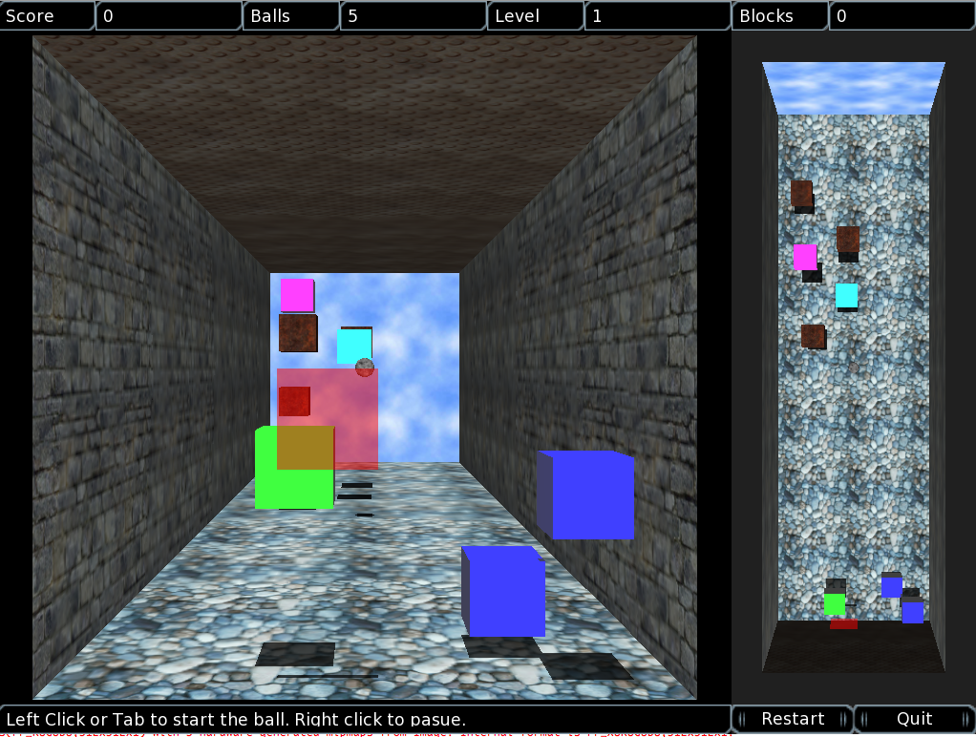
CS 391: Spring 2015
C++ Programming.
Managing small software projects.
Writing and testing games!

Slide 16
CS Elective Courses 2014-2015
Fall 2014
CS 360 Database
CS 373 Graphics
Spring 2015
CS 322 Networks
CS 371 Artificial Intelligence
CS 391 Selected Topics
PHY 240 Electronics

