Slide 1
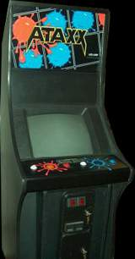
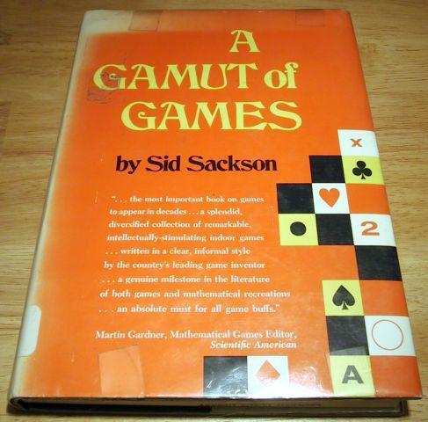
A Sampling of Chess and Chip Games
Todd W. Neller
http://cs.gettysburg.edu/~tneller/games/chessnchips.html

Slide 2
Motivation
“How could one get the most varied, quality gaming for the least cost?”
My top 5 game equipment picks for fun and variety at low cost:
Pencil and paper
Playing cards
Dice
Chess set
Poker chips
Chess set + poker chips = greatly expanded possibilities

Slide 3
A Sampling of Chess and Chip Games
Amazons
invented in 1988 by Walter Zamkauskas of Argentina
“El Juego de las Amazonas” is a trademark of Ediciones de Mente.
Ataxx
Invented by Dave Crummack and Craig Galley in 1988 and was originally called Infection
First appeared as a Leland arcade game in 1990
Believed to be in the public domain
Lines of Action
Invented by Claude Soucie
First publicized in Sid Sackson's book A Gamut of Games (1969)
A focus of AI competition in the annual Computer Olympiads
Breakthrough
Invented by Dan Troyka in 2000, originally on 7x7 board
Winner of 2001 About.com 8x8 Game Design Competition
Played competitively at http://littlegolem.net

Slide 4
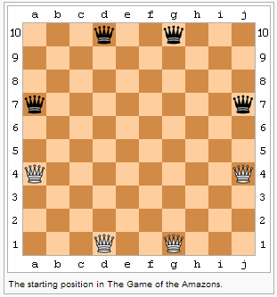
Amazons
Object: To be the last player with a legal move.
Board: square grid (10x10 standard, but smaller works)
Pieces:
4 Amazons each in light/dark colors (e.g. Chess pawns)
Markers to mark “arrows” on grid (e.g. Poker chips)
Initial setup: (see figure)
The light color plays first.
Source: Wikipedia
On a chess board, pieces can be placed at a3, c1, f1, h3 and a6, c8, f8, h6.

Slide 5
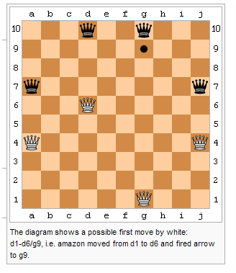
Amazons: Move
A move consists of two parts:
An Amazon of one’s color makes a non-capturing queen move.
The moved Amazon then shoots an arrow a non-capturing queen move away from the Amazon’s new space.
Amazons and arrows block spaces. Amazons do not capture. Pieces may not move on or beyond blocked spaces.
Source: Wikipedia

Slide 6
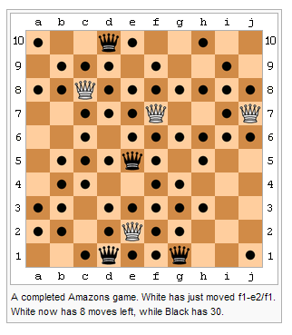
Amazons: Game End
Play sometimes ends by mutual consent when all Amazons are separated and the number of remaining legal moves is easily counted.
Source: Wikipedia

Slide 7
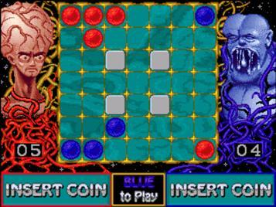
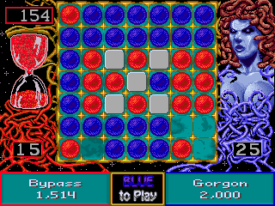
Ataxx
Object: to have the most squares with your color at game end.
Board: 7x7 square grid
Variations: some squares may be blocked, hex grid, grid size
Pieces: 2 contrasting color poker chips per grid square, stacked as in Reversi/Othello.
Initial setup: Usually two light-color-on-top stacks in two corners, and two dark-color-on-top stacks in the other two corners.
Light goes first.

Slide 8
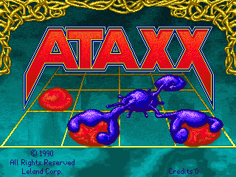
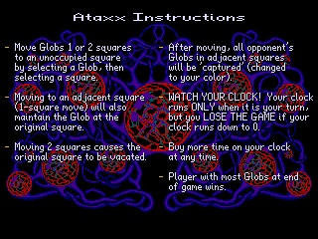
Ataxx: Move
Two types of actions:
Move a piece to an empty square 2 away. (by single orthogonal/diagonal steps)
Grow a new piece into a square 1 away.
All opponent pieces adjacent to the destination square are flipped and become your pieces.

Slide 9
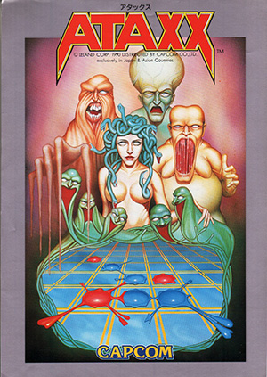
Ataxx: Game End
The game ends when neither player can move (two consecutive passes).
Alternatives: “…when the board is full”, “… when a player has no more pieces”.
Then, the player with the most pieces wins.
Draws may occur on boards with an even number of squares.

Slide 10
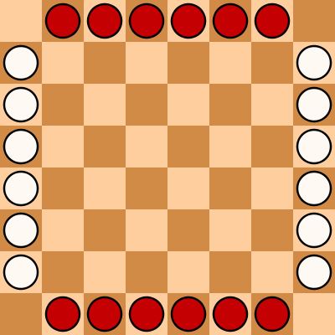
Lines of Action
Object: To be the first player to connect all of their pieces.
Board: 8 x 8 square grid
Pieces: 12 chips in each of two contrasting colors
Initial setup: (see figure)
The dark color plays first.

Slide 11
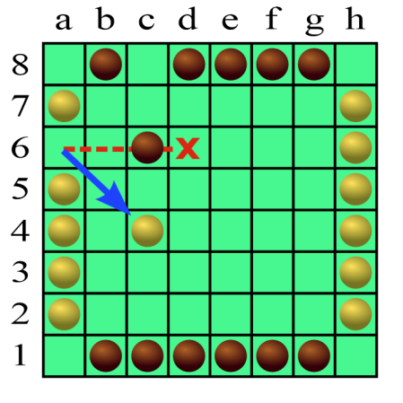
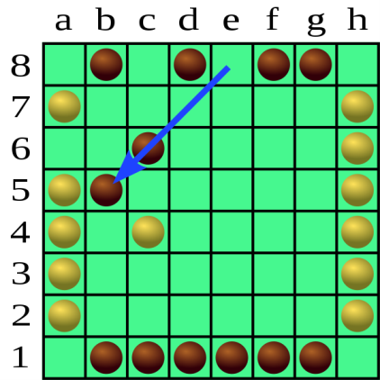
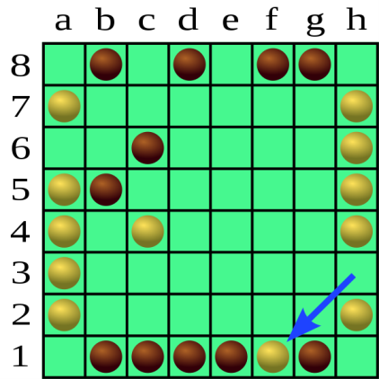
Lines of Action: Move
Chips move orthogonally/diagonally
A chip moves exactly as many spaces as there are chips of either color along the line of movement. This includes the chip itself.
A player’s chip may not jump over opponent’s chip(s), but may capture one by landing on it.
A player’s chip may jump over that player’s chip(s), but may not self-capture.

Slide 12
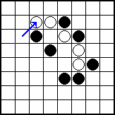
Lines of Action: Game End
The game ends when a there is a single, completely connected group of one player’s pieces.
Connections are made by orthogonal/diagonal adjacency.
Special case: simultaneous connection – a capture move both completely connects the player’s group and removes the only disconnected piece of the opponent.
Is this a draw?
NO. According to the game inventor Claude Soucie and Sid Sackson in his 2nd ed. of A Gamut of Games, the player making the simultaneous connection wins.
YES. According to Sid Sackson’s 1st ed. of A Gamut of Games and most present-day tournament rules, this is a draw.

Slide 13
Breakthrough
Abstract strategy game invented by Dan Troyka in 2000.
Originally designed for a 7-by-7 grid board.
Adapted for 8-by-8 board and winner of the 2001 About.com 8x8 Game Design Competition
Competitive online play at littlegolem.net

Slide 14
Breakthrough: Setup and Object
Materials & Setup:
Checkerboard
16 pieces per player on back two ranks (rows)
Object:
Move one of your pieces to your opponent’s back rank, or
Eliminate all opponent pieces.

Slide 15
Breakthrough: Movement
Your piece can move forward (toward your opponent) or diagonally forward into an empty space.
Your piece can capture by moving diagonally forward onto an opponent piece. The captured opponent piece is removed from the board. Captures are optional.
(Your piece is thus blocked from movement by a forward opponent, or from your own pieces.)

Slide 16
Breakthrough: Example
Red to play, red to break through to blue’s back rank and win. What is red’s correct play?
← blue’s back rank

Slide 17
Breakthrough: Example Solution
Red to play, red to break through to blue’s back rank and win. Red’s correct play moves the right piece forward. Blue must capture, but red recaptures and will be unstoppable.

Slide 18
Breakthrough: Strategy
Forward pieces are more valuable, so avoid forward trades/losses.
Keep back rank pieces as long as possible in columns 2, 3, 6, and 7.
Balance pieces between light/dark squares to avoid an easy walk through your defense.
At the same time, watch for opponent imbalances for opportunities to break through.

Slide 19
Conclusion
These are but a few game possibilities when one combines a Chess set with Poker chips.
What interesting Chess and Chip games might you invent?
More Chess and Chip games at http://cs.gettysburg.edu/~tneller/games/chessnchips.html
Enjoy!
Sources: A Gamut of Games by Sid Sackson, Wikipedia, Google images

