Slide 1
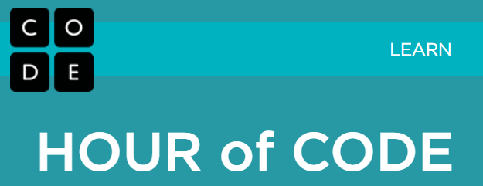
Hour of Code
Prof. Todd Neller
Gettysburg College

Slide 2
Hour of Code
What is “coding” or “programming”?
Instructing a computer to solve a problem.
Computer Scientists call programs “algorithms”.
Who can code?
You can. You learn algorithms from a young age (example: multidigit addition). You can also express algorithms with practice.

Slide 3
Why Code?
Why should I code?
It’s EMPOWERING. “Knowledge is power.” Coders work the world’s knowledge.
It’s PROFITABLE. There’s a huge need for good computer problem solvers. Large demand + small supply = $$$
It’s FUN. Being a good problem solver is creative and satisfying.

Slide 4
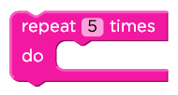
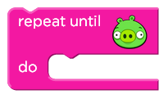
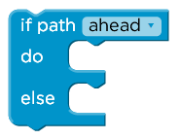
Blockly Commands
Move forward
Turn left/right
Statements
Repeat until __
Repeat __ times
Loops
If path __ do __ else __
If path __ do __
Decisions
Play

Slide 5
Coding is Like Legos
Unlike spoken languages, computer languages have few words and simple grammar rules.
With very few types of code “pieces”, we can construct code of amazing complexity.
Learning how to code
isn’t so much about the pieces, as
learning interesting patterns for combining them.

Slide 6
Python Number Guessing Game
import random
secret = random.randint(1, 100)
print('I am thinking of a number from 1 to 100.')
gameOver = False
while not gameOver:
guess = int(input('Your guess? '))
if guess == secret:
print('Correct!')
gameOver = True
else:
print('Lower.' if guess > secret else 'Higher.')

Slide 7
To Remember
Coding has simple pieces (statements, loops, & decisions) that can be assembled in complex ways to solve difficult problems.
You’ve learned algorithms. You can learn how to express them and have the computer do it!
The computer is a power tool for the mind. Knowing how to code is like having a super power.

Slide 8
Next Steps
http://tinyurl.com/gburghoc
this presentation,
more Blockly mazes,
free coding resources,
and more.
Enjoy learning more about coding!

